Slide 1

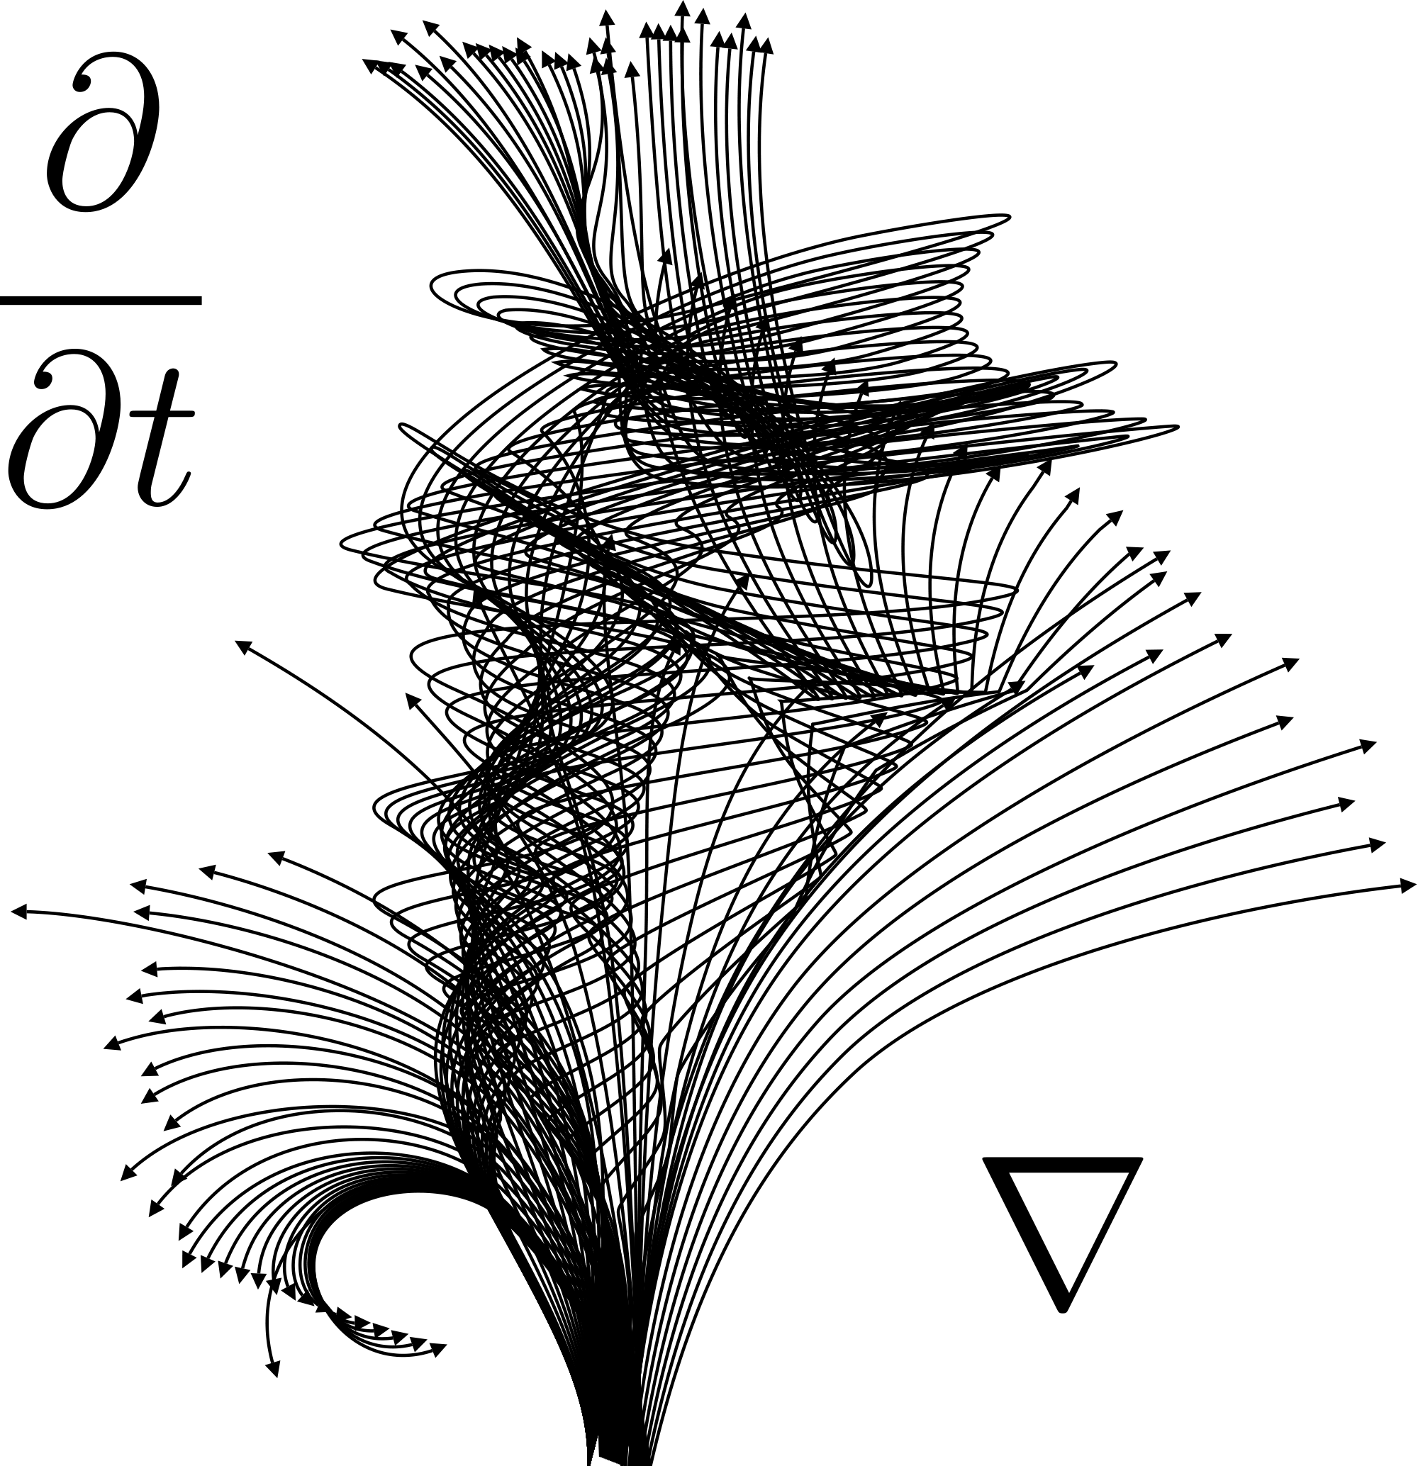

Numerical ODE Solver Comparison
Menachem Weinstein
Lin Chen
Zimin Li

Slide 2
Difference between Interpolation and Derivative.
Interpolation is the process of finding a function that passes through a given set of points. It is used to estimate the value of a function at a point that is not in the original set of points. Interpolation also provides a way to approximate the behavior of a function between known data points.
A derivative is a measure of how a function changes as its input changes. It gives the rate of change of the function at a particular point.
For example, Euler’s method approximates by using linear interpolation between the current point and the next point based on the derivative at the current point. The Runge-Kutta method uses multiple stages of interpolation to improve the accuracy of the approximation compared to the Euler method.
The solution to some differential equations cannot be expressed in a closed form. So we need to use numerical methods such as interpolation to approximate it.

Slide 3
Order of Accuracy, Local Error, and Global Error
When solving an ODE numerically, we use an approximation of the exact solution, which means that there will be some error in our solution. The error takes the form of local error and global error.
The local error is the error in each step of the solution.
The global error is the error in the final approximation of the solution, and it is the sum of the local errors over all the steps. To calculate the global error, we need to know the exact solution of the ODE.
The order of accuracy is a measure of how quickly a numerical method for solving an ODE converges to the true solution as the step size is decreased.
A numerical method is said to be of order p if the global error is proportional to the step size h raised to the power p.
The order of accuracy can be used to compare different Runge-Kutta methods.
If two methods have the same number of iterations, the one with the higher order of accuracy will generally be more accurate for a given step size.

Slide 4
Stability
Refers to the behavior of a numerical method when the step size (h) is varied. A stable method produces reliable and accurate results regardless of the step size, while an unstable method can lead to unpredictable and unreliable solutions.
There are different types of stability that can be assessed in numerical methods:
Absolute Stability: A method is absolutely stable if it produces bounded errors for all step sizes within a certain range.
Conditional Stability: A method is conditionally stable if it produces bounded errors only for a specific range of step sizes or parameters.
A-stability: A-stability refers to the ability of a numerical method to remain stable for any step size
L-stability: L-stability refers to the ability of a numerical method to remain stable for rapid changes.

Slide 5

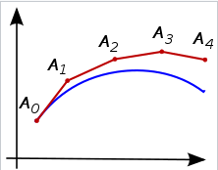
Euler’s Method (The First-Order Method)
Euler’s method approximates the solution by using two points, the derivative at a single point and taking a single step in a direction.
As Euler’s method approximates the derivative to the first order, it assumes a linear relationship between the function and its derivative. This not very accurate as it ignores curvature.

Slide 6
First Order Euler Result I
Cases | Setting | Result | Actual | Accuracy | Run Time (second)
Sinx+cosx | f(0)=1, endpoint=2, 10 steps | 3.28100 | 3.32544 | 98.64% | 0.006
2y-6x+11 | f(0)=5, Endpoint=4, 5 steps | 72814.8 | 26836.6 | -71.33% | 0.007
-xy | f(0)=10, endpoint=10, 10 steps | 7.6398*10^(-41) | 1.92875*10^(-21) | 100% | 0.008
exp(sinx+cosx) | F(0)=10, endpoint=10, 70 steps | 117.96 | -11972.9 | -0.99% | 0.005
X^3+y-2 | F(0)=3, endpoint=20, 10 steps | 276.326 | 3.39615*10^9 | 8.13*10^(-6)≈0% | 0.006

Slide 7
First Order Runge Kutta Result II
Case (y[0]=3) | Parameter | Step Size Accuracy (with end point fixed at 20, actual result is 3.39615*10^9) | End Point Accuracy (with step size fixed at 500, actual result)
X^3+y-2 | 1 | 276.326/3.39615*10^9(0%) | 24.1586/5.0280(480.48%)
X^3+y-2 | 10 | 276.326/3.39615*10^9(0%) | 203.312/152822(0.13%)
X^3+y-2 | 50 | 371.875/3.39615*10^9(0%) | 999.603/3.62930*10^22 (0%)
X^3+y-2 | 100 | 388.268/3.39615*10^9(0%) | 1994.93/1.88168*10^44(0%)
X^3+y-2 | 500 | 402.387/3.39615*10^9(0%) | 9957.35/9.82513*10^217(0%)

Slide 8

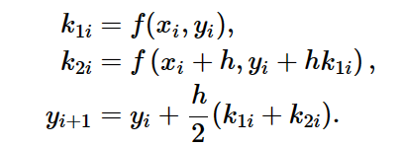
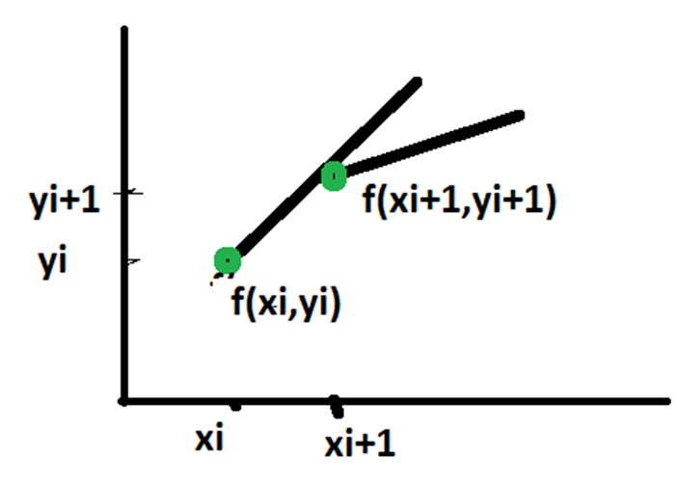
The Second-Order Method
Improved Euler Method is second order method.
The Second Order Method is a more accurate approximation of the derivative compared to first-order methods by estimating the derivative at the midpoint between two points.
By considering the slope at the midpoint, it captures more curvature information, leading to improved accuracy.

Slide 9
Improved Euler Method Results I
Cases | Setting | Result | Actual | Accuracy | Run time (second)
Sinx+cosx | f(0)=1, endpoint=2, 10 steps | 3.31768 | 3.32544 | 99.77% | 0.009
2y-6x+11 | f(0)=5, Endpoint=4, 5 steps | 26036.2 | 26836.6 | 97.02% | 0.011
-xy | f(0)=10, endpoint=10, 10 steps | 1.17899*10(-14) | 1.92875*10(-21) | 100% | 0.013
Exp(x)(sinx+cosx) | F(0)=10, endpoint=10, 70 steps | -15114.8 | -11972.9 | 73.76% | 0.009
X^3+y-2 | F(0)=3, endpoint=20, 10 steps | 1.22061*10^8 | 3.39615*10^9 | 3.59% | 0.008

Slide 10
Improved Euler Method Results II
Case (y[0]=3) | Parameter | Step Size Accuracy (with end point fixed at 20, actual result is 3.39615*10^9) | End Point Accuracy (with step size fixed at 500, actual result)
X^3+y-2 | 1 | 80223(0%) | 5.028/5.028(100%)
X^3+y-2 | 10 | 1.22061*10^8(3.59%) | 152740/152822(99.95%)
X^3+y-2 | 50 | 2.38779*10^9(70.31%) | 3.37063*10^22/3.62930*10^22(92.87%)
X^3+y-2 | 100 | 3.06623*10^9(90.28%) | 1.07287*10^44/3.62930*10^22(0%)
X^3+y-2 | 500 | 3.38054*10^9(99.54%) | 8.08850*10^199/9.82513*10^217(0%)
Pros: simple method, short running time, high accuracy with polynomial of degree 1 and 2. Conditional stable method. For this example, once it is converged, it remain converged.
Cons:
struggle with high degree function. To be specific, the accuracy is low with step size lower than 50. Convergence is slow for high order function. Takes 100 steps to achieve 90% accuracy.
When the prediction point is far away from starting point, the accuracy suffer.

Slide 11
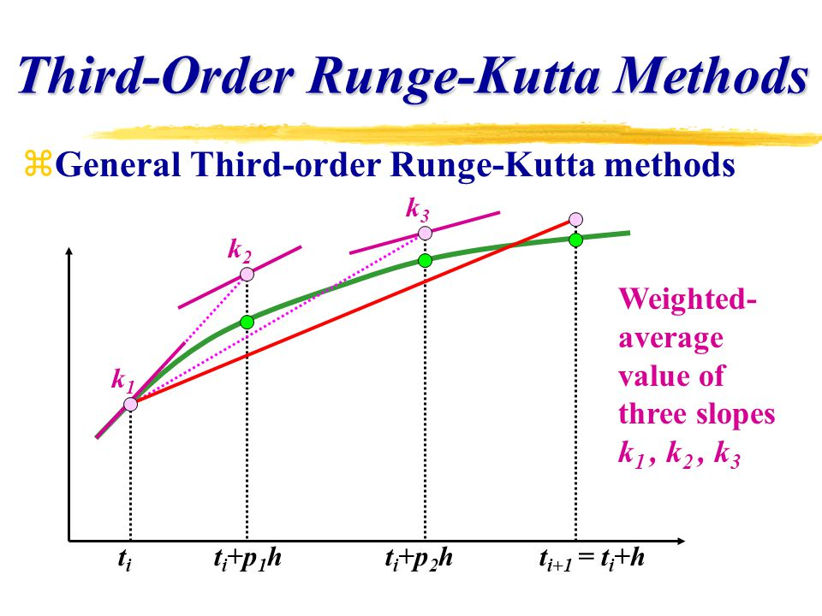
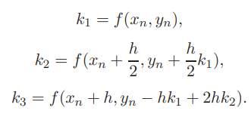

The Third-Order Method
Also known as the Heun method or the third-order Runge-Kutta method. This method provides a more accurate approximation of the derivative compared to simpler methods like Euler's method.
The formula for the third-order method can be expressed as follows:

Slide 12
Third Order Runge Kutta Result I
Cases | Setting | Result | Actual | Accuracy | Run Time (second)
Sinx+cosx | f(0)=1, endpoint=2, 10 steps | 3.32544 | 3.32544 | 100% | 0.012
2y-6x+11 | f(0)=5, Endpoint=4, 5 steps | 26804.6 | 26836.6 | 99.88% | 0.010
-xy | f(0)=10, endpoint=10, 10 steps | 7.6235*10^(-25) | 1.92875*10^(-21) | 100% | 0.010
Exp(x)(sinx+cosx) | F(0)=10, endpoint=10, 70 steps | -11957.8 | -11972.9 | 99.87% | 0.009
X^3+y-2 | F(0)=3, endpoint=20, 10 steps | 8.59854*10^8 | 3.39615*10^9 | 25.32% | 0.010

Slide 13
Third Order Runge Kutta Result II
Case (y[0]=3) | Parameter | Step Size Accuracy (with end point fixed at 20, actual result is 3.39615*10^9) | End Point Accuracy (with step size fixed at 500, actual result)
X^3+y-2 | 1 | 174890/3.39615*10^9 (0%) | 5.0280/5.0280(100%)
X^3+y-2 | 10 | 8.59854*10^8/3.39615*10^9(25.32%) | 152823/152822(99.99%)
X^3+y-2 | 50 | 3.27827*10^9/3.39615^10^9(96.53%) | 3.62258*10^22/3.62930*10^22 (99.81%)
X^3+y-2 | 100 | 3.37859*10^9/3.39615*10^9(99.48%) | 1.82983*10^44/1.88168*10^44(97.24%)
X^3+y-2 | 500 | 3.39601*10^9/3.39615*10^9(99.99%) | 7.00805*10^213/9.82513*10^217(0%)
Pros: Achieve higher accuracy than Euler and Improved Euler method. Similar running time as Euler and improved Euler method. Quick convergence for linear and parabola function. Stable method.
Cons:
When the prediction point is far away from the starting point, the accuracy is low.
Not well of handling higher degree polynomial function.

Slide 14
Fourth Order Interpolation Method Results I
Cases | Setting | Result | Actual | Accuracy | Run Time (second)
Sinx+cosx | f(0)=1, endpoint=2, 10 steps | -43.993 | 3.32544 | 0% | 0.012
2y-6x+11 | f(0)=5, Endpoint=4, 5 steps | 9928.255 | 26836.6 | 37.00% | 0.554
-xy | f(0)=10, endpoint=10, 10 steps | -1.797874*10^7 | 1.92875*10^(-21) | 0% | 0.602
Exp(x)(sinx+cosx) | F(0)=10, endpoint=10, 70 steps | -1.791152*10^55 | -11972.9 | 0% | 0.978
X^3+y-2 | F(0)=3, endpoint=20, 10 steps | -1.045711*10^8 | 3.39615*10^9 | 0% | 1.178

Slide 15
Fourth Order Interpolation Method Result II
Case (y[0]=3) | Parameter | Step Size Accuracy (with end point fixed at 20, actual result is 3.39615*10^9) | End Point Accuracy (with step size fixed at 1, actual result)
X^3+y-2 | 1 | 4.670588*10^8/3.39615*10^9 (13.75%) | 5.0257/5.0280(99.99%)
X^3+y-2 | 10 | -1.045711*10^8/3.39615*10^9(25.32%) | 123751/152822(80.98%)
X^3+y-2 | 50 | -2.301643*10^38/3.39615^10^9(0%) | 3.31170743*10^15/3.62930*10^22 (0%)
X^3+y-2 | 100 | -3.11553*10^81/3.39615*10^9(0%) | 3.9196418*10^21/1.88168*10^44(0%)
X^3+y-2 | 500 | -2.083589*10^436/3.39615*10^9(0%) | 3.8486697*10^36/9.82513*10^217(0%)
Pros: simple method.
Cons:
Accuracy is generally much lower than all the rest of methods.
Increase the step size does not help in convergence and on the contrary, it is even worse. When the predicted point is far away from the start point, the accuracy is low.
Unstable method. In this example, it starts to converge and then diverge again
Take much longer time than the rest of methods

Slide 16
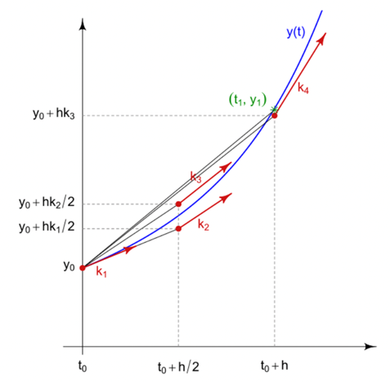
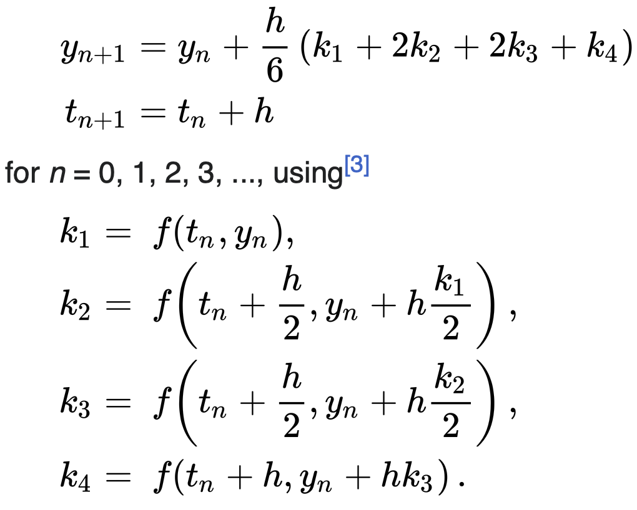
The Fourth-Order Method
The fourth-order method, also known as the classical Runge-Kutta method. (RK4)
It improves upon simpler methods like Euler's by estimating the derivative at multiple points within a time-step to achieve a more accurate approximation.
The 4th order Runge-Kutta method takes four estimates: one at the beginning of the step, two in the middle, and one at the end.

Slide 17
RK4 Result I
Case (y[0]=3) | Parameter | Step Size Accuracy (with end point fixed at 20. Actual result is 3.39615*10^9) | End Point Accuracy (with step size fixed at 500, compare with actual result) (MV / OV)
x^3+y-2 | 1 | 848223 (0%) 0.005s | 5.02803 / 5.0280 (100%) 0.012s
x^3+y-2 | 10 | 2.10287*10^9 (61.92%) 0.014s | 152823 / 152822. (99.99935%) 0.013s
x^3+y-2 | 50 | 3.38673*10^9 (99.72%) 0.014s | 3.62934*10^22 / 3.62930*10^22 (100%) 0.012s
x^3+y-2 | 100 | 3.39537*10^9 (99.97%) 0.013s | 1.87949*10^44 / 1.88168*10^44 (100%) 0.020s
x^3+y-2 | 500 | 3.39608*10^9 (99.998%) 0.012s | 1.58249*10^217 / 9.82513*10^217 (16.17%) 0.015s

Slide 18
Cases | Setting | Result | Actual | Accuracy | Run time (Seconds)
sinx+cosx | f (0) = 1 Endpoint: 2 10 steps | 3.32544 | 3.32544 | 100% | 0.026
2y-6x+11 | f (0) = 5 Endpoint: 4 50 steps | 26835.3 | 26836.6 | 99.995% | 0.027
-xy | f (0) = 10 End point: 10 70 steps | 9.3235*10^(-21) | 1.92875*10^(-21) | 100% | 0.031
e^x(sinx+cosx) | f (0) = 10 End point: 10 10 steps | -11957.8 | -11972.9 | 99.87% | 0.017
x^3+y-2 | f (0) = 3 End point: 20 10 steps | 2.10287*10^9 | 3.39615*10^9 | 61.92% | 0.014
High accuracy for smaller endpoint and larger step size.
Lower accuracy for larger endpoint and larger step size.
Larger global error might caused by lots of local errors.

Slide 19
Comparison of methods
 | Accuracy | Stability | Runtime | Conclusion
Euler’s method | Not so accurate | Unstable | Shorter | Not recommend
Improved Euler’s method | High accuracy for degree 1 and 2 polynomial | Not very stable | Shorter | Recommend for lower degree polynomial with smaller endpoint
3rd Order Runge-Kutta | Higher accuracy if increasing step size | Stable | Shorter | Recommend for lower degree polynomial with smaller endpoint
Interpolation | Not accurate | Unstable | Much longer | Not recommend
4th Order Runge-Kutta | Most accurate | Stable | Longer | Recommend since it has highest accuracy

Slide 20
Conclusion
Euler’s method runs faster for order of h and h^2, but less accuracy.
The Runge-Kutta method tends to be more accurate than the Euler’s method for a fixed step.
4th Order interpolation method is not recommended due to its inaccuracy and longer runtime.
Higher order with fixed endpoint, higher accuracy.
The endpoint cannot be very large.

